Slide 1
BEN AŞK ADAMIYIM MAN of LOVE

Slide 2
BEN AŞK ADAMIYIM
Dolaştığım denizlerce düşünüyorum,
Bineceğim son gemi değil midir
Hayır sahibi omuzlarda giden tabut?
Herkes gibi teselliye muhtaç olsaydım eğer,
Derdim ki: "Elbet bir ağlayanım olur benim de;
Ramazan geceleri Yasin okuyanım,
Baharda kabrime menekşe getirenim de."

Slide 3
Fakat bütün bunlar olmasa da olur,
Yine tasa etmem,
Yine kırılmam kimseye.
Ben aşk adamıyım,
Sevmeye geldim insanları,
Gönlümle, elimle, kafamla sevmeye;
Hesapsız, karşılıksız,
Ayrılık gayrılık gözetmeden.

Slide 4
Gün gelip gidersem şayet,
Öyle severekten gideceğim ki,
Karanlık kıyılardan bile olsa,
Candan selamlarım,
Civarımdan geçecek gemileri;
Güneşli gemileri;
Şarkılı gemileri;
İçlerinde kendim varmışım gibi!

Slide 5
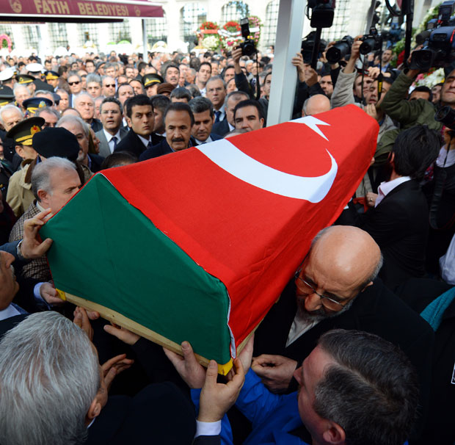
Man of love
Through the seas I have travelled thinking
Is it not the last ship I will Take
On philanthropists’ shoulder; a coffin

Slide 6
Like everyone were I need any comfort
I would say “Eventually someone will feel sorrow for me
In Ramadan will pray for me
Will bring violet to my tomb.”

Slide 7
It still doesn’t matter
Unless it happens
Still I don’t mind, I am not offended
This is the cause of my presence
I am a man of love
I exist for love
This is all my possession

Slide 8
Love with my heart with my hand with my mind
With countless love
With unreturned love
Without discrimination; with inclusion

Slide 9
If I pass away at any time
Will do it with such a love that
I shall greet all the ships around
Even the ones in the darkest shores
With all my heart
The sunny ships
The singing ships
As though I was in those ships

Slide 10
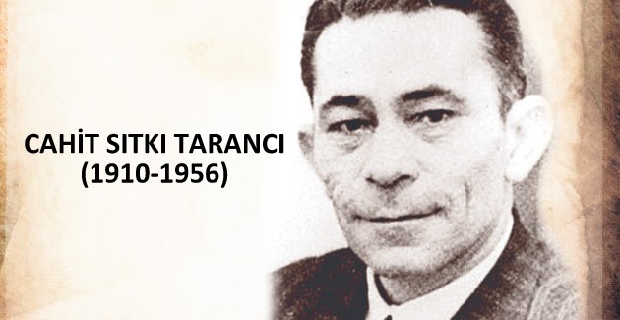

Slide 11
Cahit Sıtkı Tarancı is one of the most important figures of the Republican Period of Turkish Literature. It is possible to see both French symbolism’s effects and Turkish literature’s historical background on his Works.

Slide 12
Themes that he often works are fear of death, desire of living and human relationship based on brotherhood. Associated with these themes, it is seen that his poems are also related to existentialism. He mentioned love, childhood memories, loneliness etc. in addition to these themes.

Slide 13
Let the day not fall away from my fenster
Neither I have authority over the rising day
Nor one who sympathizes can be found
Ah my death crosses my mind
Then this bird, this garden, this heavenly light
And heart says that to its God:
I have no concern of suffering you give
I willingly give my consent to every trouble, as long as
Let the day not fall away from my fenster.

Slide 14
THANK
YOU

