Slide 1
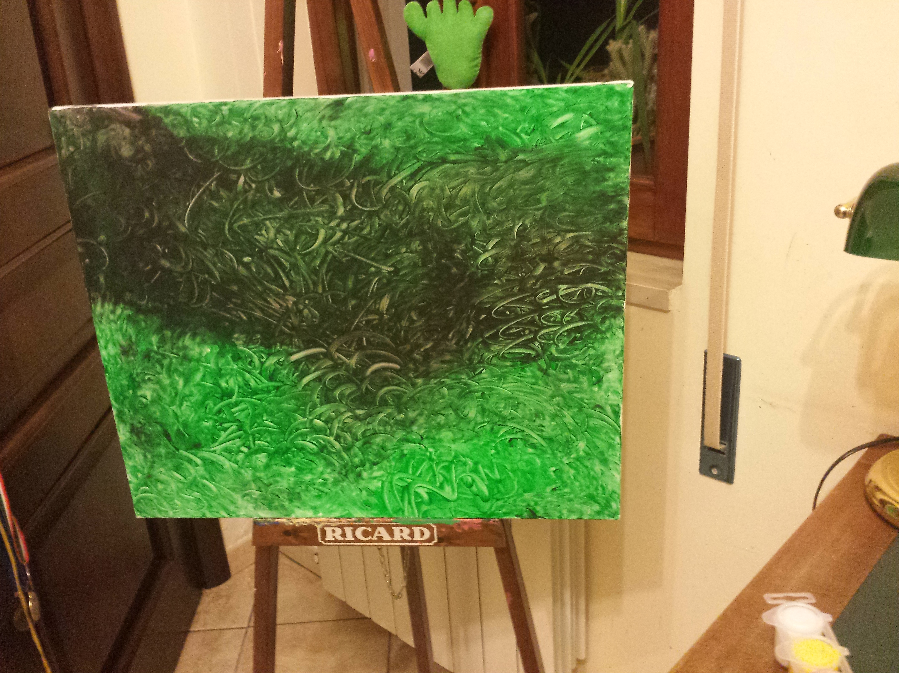
I LOVE PAINTING
Hola…I’m Riccardo Bentivegna I ‘m 14 years old… this is one of drawings, I like painting with fingers like the famous painter Pollock

Slide 2
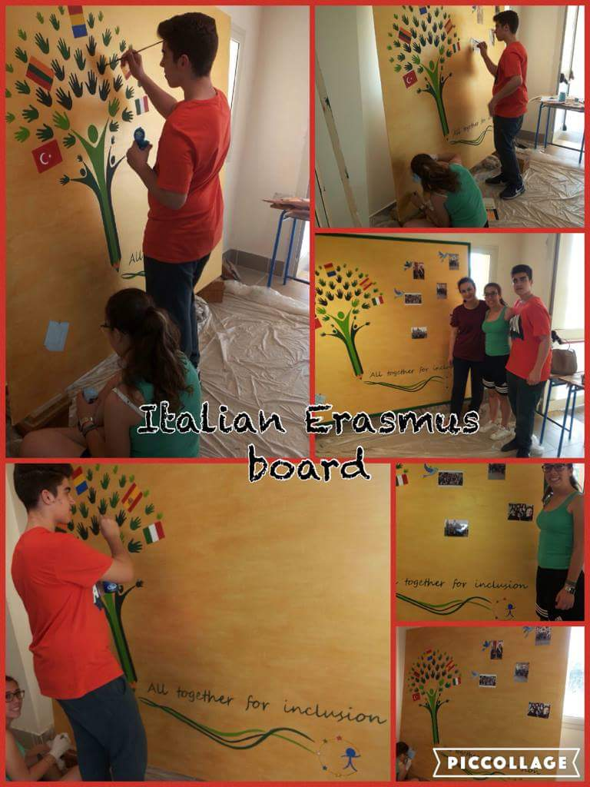

Slide 3
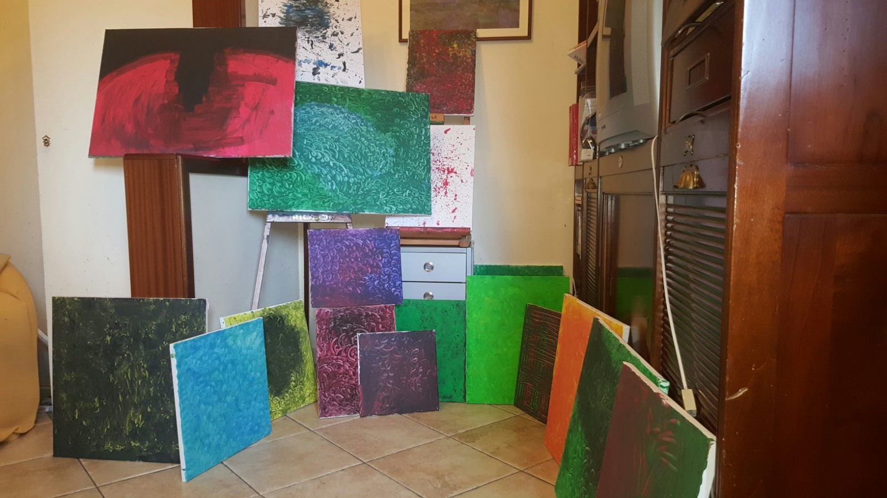
AT WORK
As you can see I am not alone…there were Giulio Nisi and Cristina Trombetta.
Maybe you met them in Romania …we work all together for a week and we have to say thank you to our teacher Rosanna Leonardi because she was nice and patient with us……

Slide 6
WE ARE WAITING FOR YOU TO ADD YOUR PICS IN THE Erasmus corner! I hope that you like it…that’s all Folks………!

Slide 7
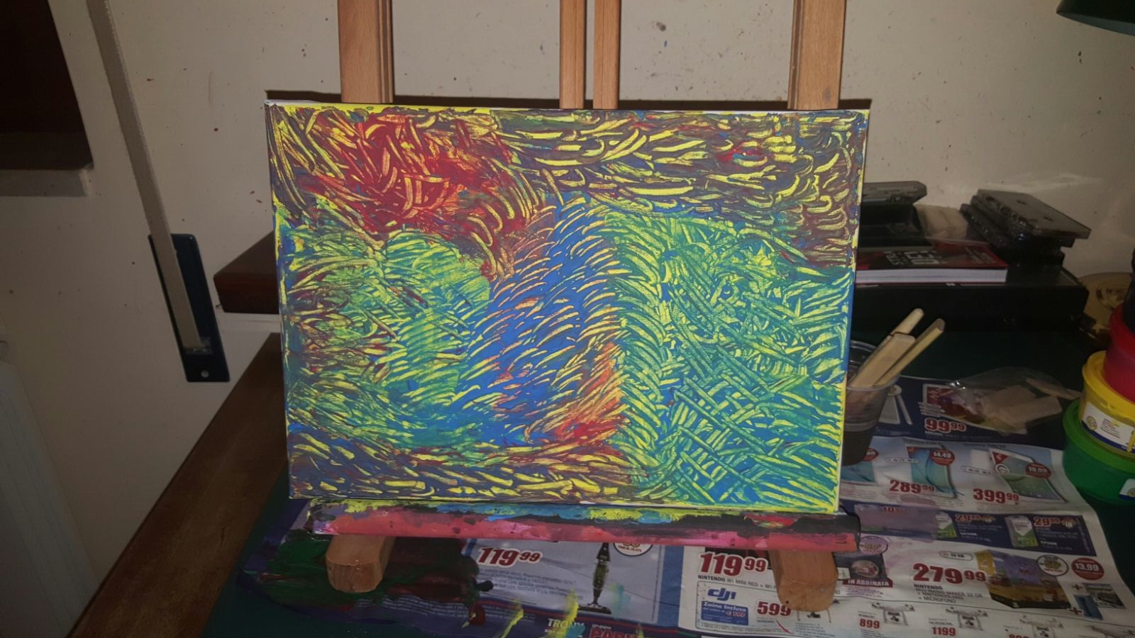
Riccardo bentivegna 2° c-CLASSICO i.i.s. « concetto marchesi» mascalucia-italy

