Slide 1
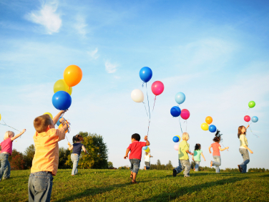
Poem classroom All together for Inclusion (ALTER)
Orphans
By Adrian Paunescu

Slide 2
Romanian Version
Orfani A fi om e mai greu decât plumbul pe lume, Noi nici nume n-avem. Dar câţi oameni au nume? Ne-aţi uitat în cămin şi ni-i greu şi ruşine, Mai cumplită, oricum, e uitarea de sine. Suntem răi între noi, tot ce-i rău ne-răieşte, Cei mai răi sunt acei ce urăsc omeneşte. Noi - parinţi nu avem, cum destinul ne arată, Pe pământ, cei mai mulţi n-au nici mamă, nici tată. Poate că, între noi, peste traiul de câine, Sunt cei supradotaţi pentru lumea de mâine. Şi mai mare ca noi e, oricum, altă rană, Un popor de orfani, într-o lume orfană.

Slide 3
English version

Slide 4
Poem analysis
The text of the poem focuses on the depiction of a world in which humans lose their sense of responsibility and fail to care for those around them who are in great need for acceptance and tolerance.
The orphans in the poem are the children and people in need. The poet places himself as one of those people, and cries out for acceptance and inclusion.

Slide 5
The first line of the poem To be human in the world is heavier than lead refers to the difficulties encountered by people in dealing with special needs people, being seen as a weight, a problem that needs solutions.
The second line We have no names. But how many humans have names? shows that people with problems are often neglected or ignored, being considered without names. But the poet goes on to ask all of us whether we have names ourselves, since we choose to neglect and not include the special needs people in our society.
The lines You’ve left us isolated, and it’s hard and shameful/More terrible, anyways is oblivion itself present the cry for help and the gravity of the situation in which people treat the people with problems. The poet uses the word oblivion (left to be forgotten) to emphasize the carelessness with which many people treat the problem of social inclusion and acceptance.

Slide 6
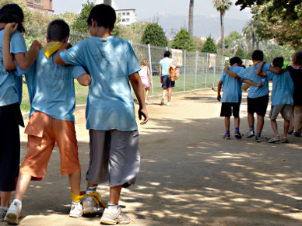
We’re mean to each other, all that’s mean makes us meaner, /And the meanest are those who hate humanity. The next lines point out that the world is becoming a place in which hate breeds more hate, evil breeds more evil, and the greatest problem people are confronted with is their loss of humanity. The poet highlights the ever-lasting circle from which we need to exit in order to change as people and become better, more tolerant.
We – orphans of parents, as destiny shows us,/On Earth, most of us have neither mother nor father. Semantically speaking, the next lines can be interpreted as follows: the orphans are the children and people with special needs, who have no guardians or people to stand by their cause (they are seen as orphans of parents). The poet underlines that most people with special needs have no real guardians, (mother or father), but also uses the word MOST, which implies the existence of a small number of people ready and willing to make a change in the world and create a better environment for the acceptance of the people in need.

Slide 7
Perhaps, among ourselves, above the hardships we endure, /Are those endowed for tomorrow’s world. In the following lines the tone of the poem shifts from a pessimistic one to an optimistic one, as the poet presents a ray of hope that resides in those among us who are endowed (detain the necessary knowledge) for tomorrow’s world (for the future). They are the people who stand out to bring about the much needed change when it comes to the inclusion of special needs people.
And greater than us is, however, another wound, /A people of orphans, in an orphan world.
The poem concludes in a sad note, that also shows a cruel reality and a cry for self-awareness, and need for change. A people of orphans in an orphan world refers to the ever-presence of people with special needs throughout the world and the struggle we are all facing in looking after their needs and making the world a better place for them.

Slide 8
The poet’s style is quite straightforward. He makes use of few stylistic devices. He uses similes, enumerations and metaphor to convey hidden meaning. He mostly relies on the semantics and the multiple interpretations that can be attributed to the poem. On the one hand, it can be read as a manifesto for the acceptance of people with special needs. On the other hand, it can also be read simply as the cry of an orphan boy who finds the world around him unwilling to accept him.
The poet is famous for his sympathy towards all people and the ideas of freedom and democracy. He has always been a patriot, fighting against censorship during the communist regime. His fervor and passion can be seen in most of his writings.

Slide 9
Adrian Păunescu

Slide 10
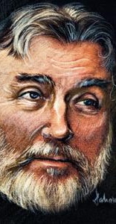
Adrian Păunescu 20 July 1943 – 5 November 2010) was a Romanian poet, journalist, and politician. Păunescu was called "Romania's most famous poet„ in an Associated Press story, quoted by the New York Times.
Life
Born in Copăceni, Bălţi County, in what is now the Republic of Moldova, Păunescu spent his childhood in Bârca, Dolj County. He did his secondary studies at Carol I High School in Craiova.
Păunescu studied philology at the University of Bucharest and became a writer and journalist. He was an influential public figure for Romanian youth throughout the 1970s and early 1980s. Păunescu remained popular in Romania, where he appeared on television several times a week.
As posthumously summarized by newspaper România Liberă, Păunescu "is still viewed as a hero by the man in the street“.

Slide 11
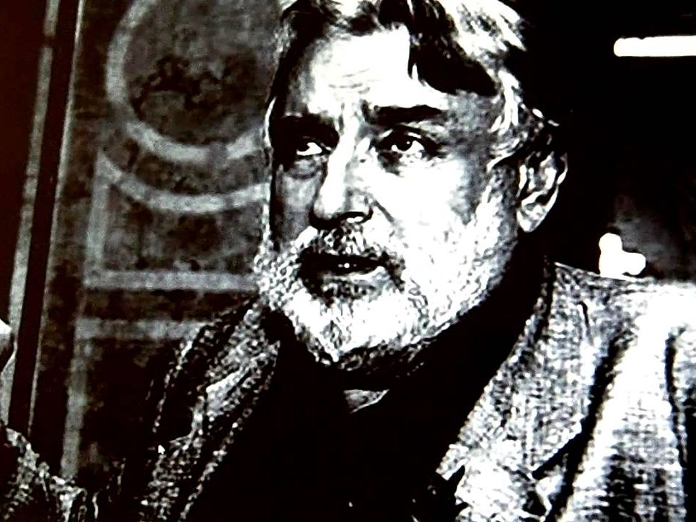
Paunescu is loved by many for his poetry (and trying to be objective, he did write some nice ones) and the memories he brings back of the patriotism during the '70s and '80s. However, not everyone has such affectionate memories, attesting that these gatherings were pure manipulation and an attempt to brainwash.
His straightforward style comes from his desire to be a patriot and fight for justice, honour and dignity.
Many of his poems have also been sung by musicians and turned into successful songs.

Slide 12
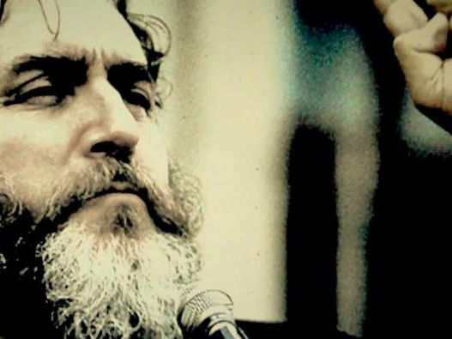
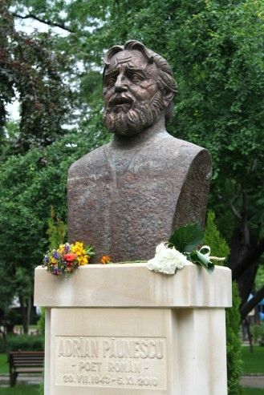
To conclude, Adrian Paunescu was indeed a genius - but only in his manipulating capacity. He was essentially a patriot in all respects as far as critics can see.
To honour his memory, a bust was erected after his passing away.

Slide 13
Thank you for your attention!

